Slide 1
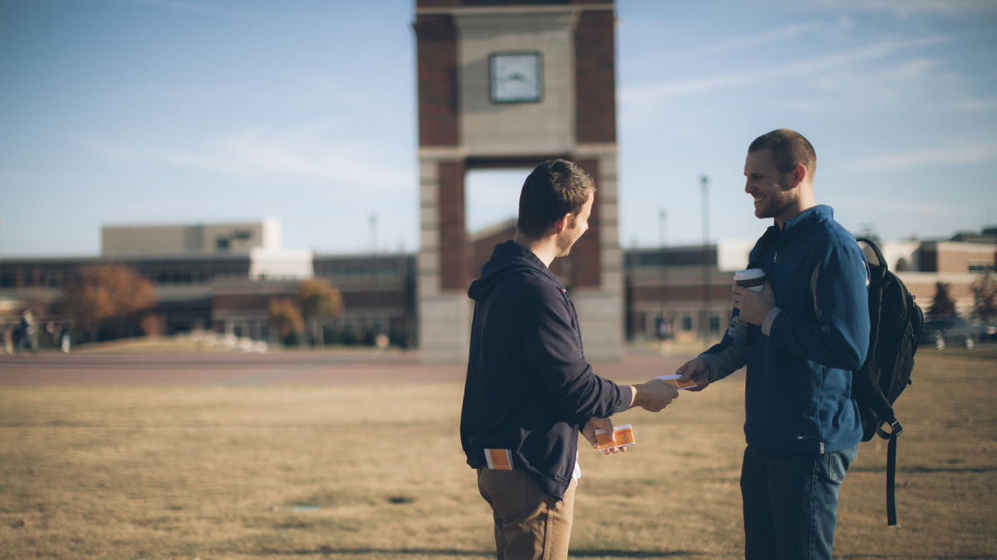
One by One
Why your witness is more important than ever

Slide 2
Share an evangelism experience you’ve had.
Notes:
Pair/Share then Group Share

Slide 3
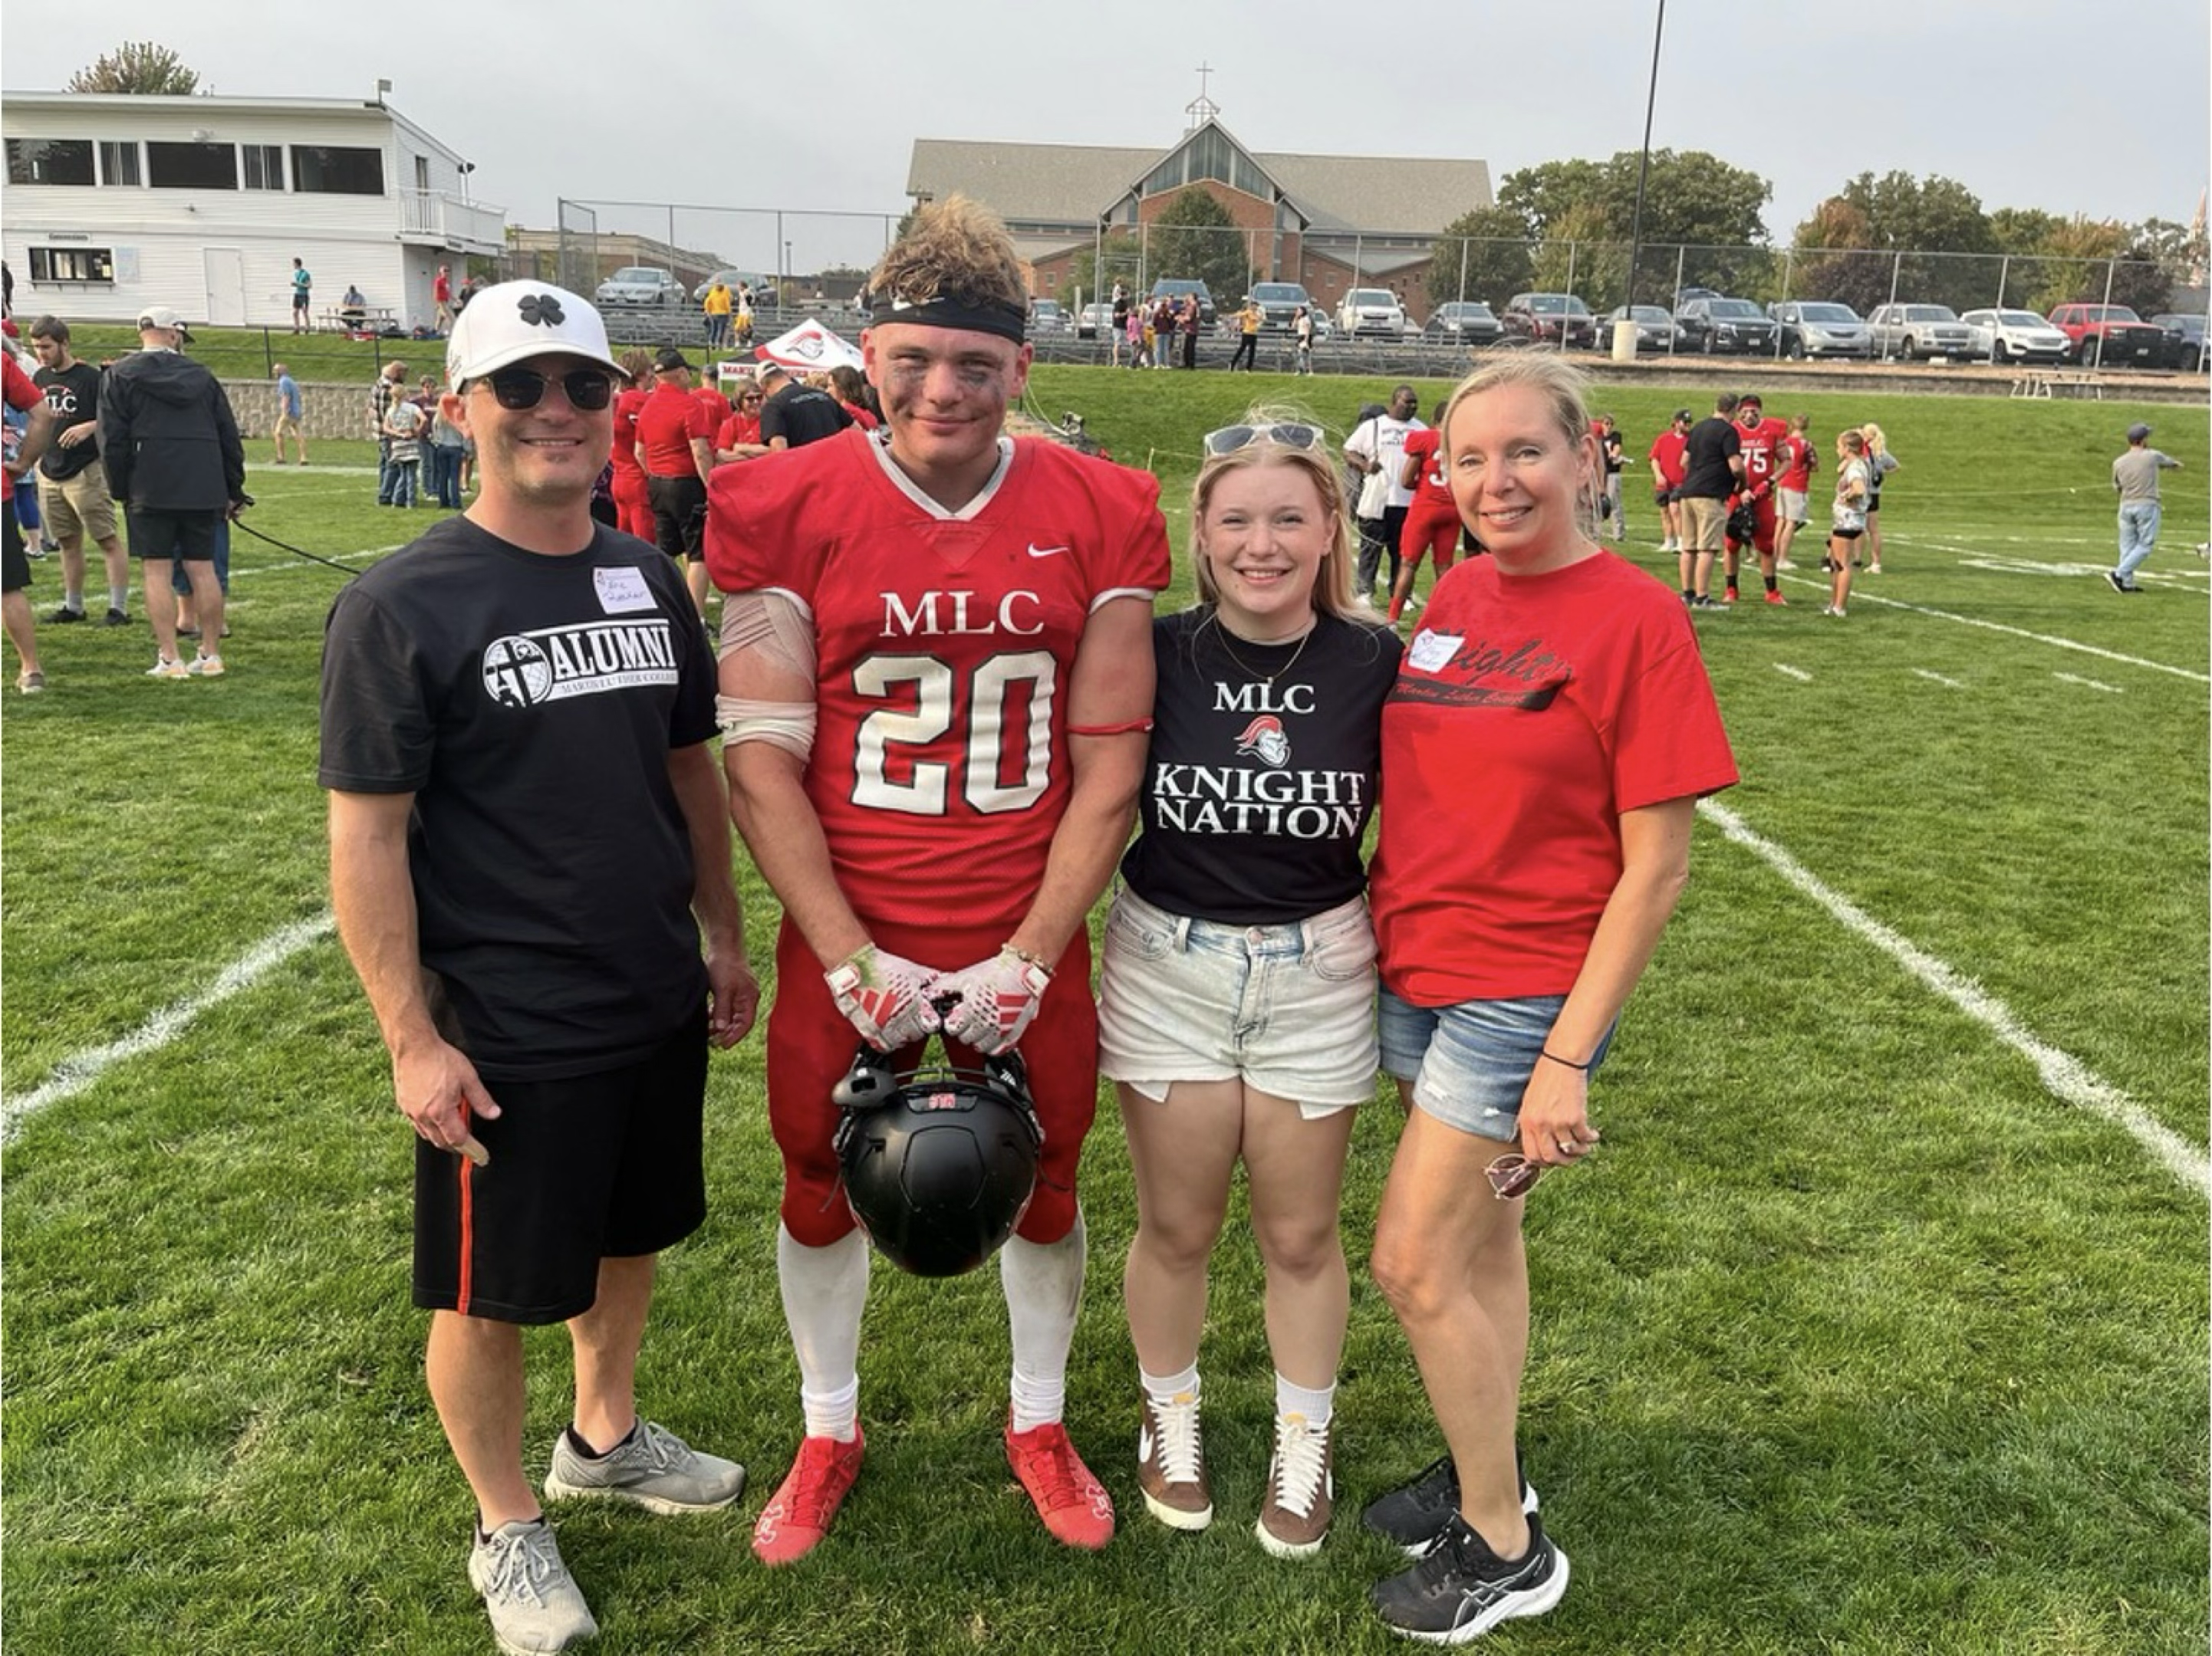

Slide 4
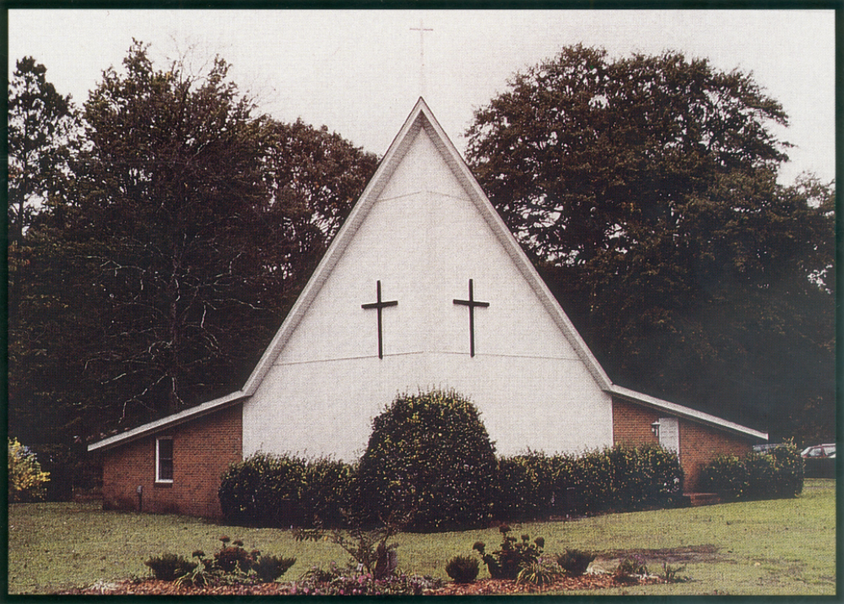

Slide 5
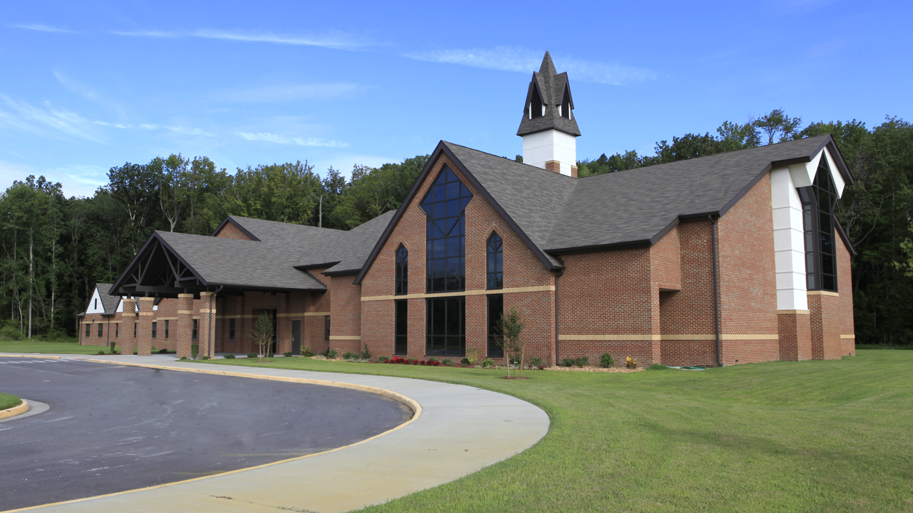

Slide 6


Slide 8
Why?
What?
How?
Personal
Evangelism

Slide 9
Why?
What?
How?
Personal
Evangelism

Slide 10

Why?
The rise of the Unaffiliateds
Notes:
Sometimes called the “Nones”
This seems better

Slide 11
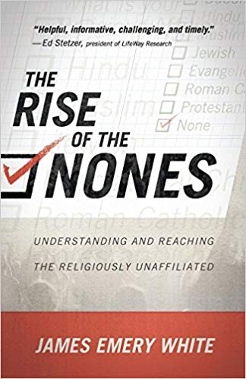
Notes:
We already summarized the challenge: Christianity in America is unraveling. This is chronicled well in the book The Rise of the Nones by James Emery White. White demonstrates how more and more, Americans are not identifying with any religion. This does not mean they become atheists. They perhaps still believe in God and pray. They just don’t want to associate with any particular denomination. And they certainly don’t want to go to church. Currently, 1 in 4 Americans claims no religious identity. The trend is worse among younger generations. With those 30 and younger, it’s between 42 and 45%.

Slide 12
Notes:
We already summarized the challenge: Christianity in America is unraveling. This is chronicled well in the book The Rise of the Nones by James Emery White. White demonstrates how more and more, Americans are not identifying with any religion. This does not mean they become atheists. They perhaps still believe in God and pray. They just don’t want to associate with any particular denomination. And they certainly don’t want to go to church. Currently, 1 in 4 Americans claims no religious identity. The trend is worse among younger generations. With those 30 and younger, it’s between 42 and 45%.

Slide 13
Notes:
We already summarized the challenge: Christianity in America is unraveling. This is chronicled well in the book The Rise of the Nones by James Emery White. White demonstrates how more and more, Americans are not identifying with any religion. This does not mean they become atheists. They perhaps still believe in God and pray. They just don’t want to associate with any particular denomination. And they certainly don’t want to go to church. Currently, 1 in 4 Americans claims no religious identity. The trend is worse among younger generations. With those 30 and younger, it’s between 42 and 45%.

Slide 14
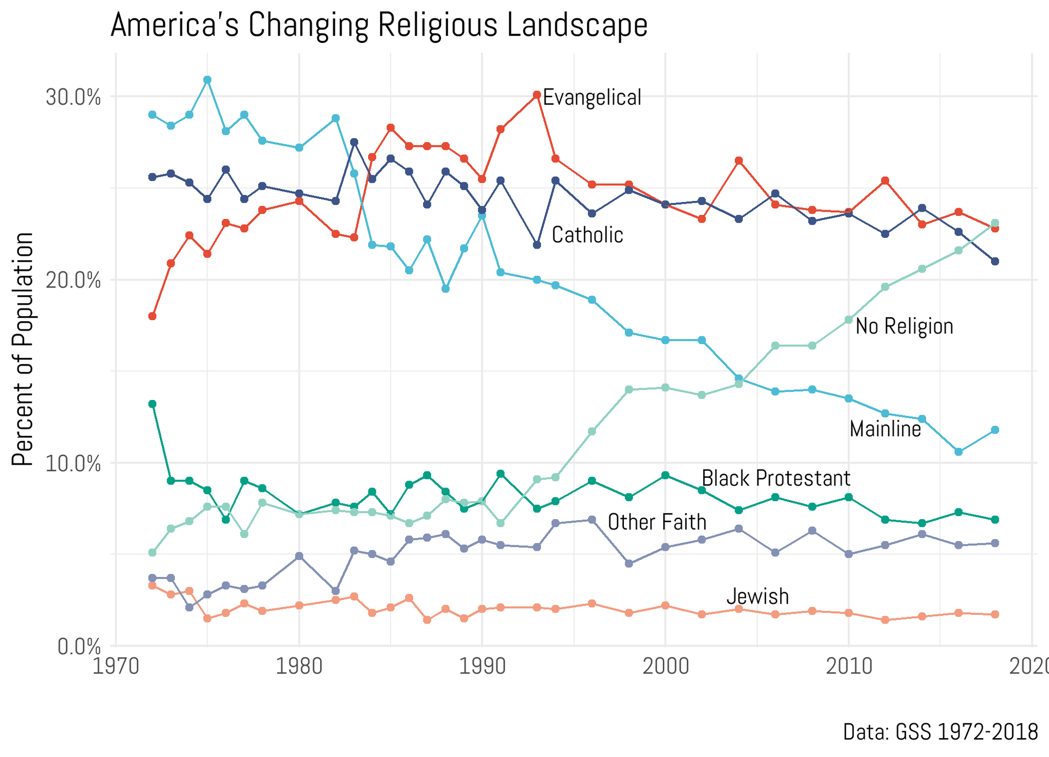
Notes:
This data comes from the General Social Survey out of the University of Chicago.
Mainline denominations
The Evangelicals
Catholics
No Religion

Slide 15




Notes:
This data comes from the General Social Survey out of the University of Chicago.
Mainline denominations
The Evangelicals
Catholics
No Religion

Slide 16


The Religious Landscape
39% 13-25 year-olds
Source: General Social Survey

Slide 17
There were 36.6 million religiously unaffiliated Americans in 2007.
There were 63.2 million religiously unaffiliated Americans in 2017.
That is a 72.6% increase in one decade.
Notes:
Just to highlight this issue. In just one decade, the number of Americans who identify as having no religion grew by about 26-million people, a 72.6% growth rate. Currently, it is close to 70 million Americans who claim to have no religious affiliation. The upside of this is that we are surrounded by a ripe mission field.

Slide 18
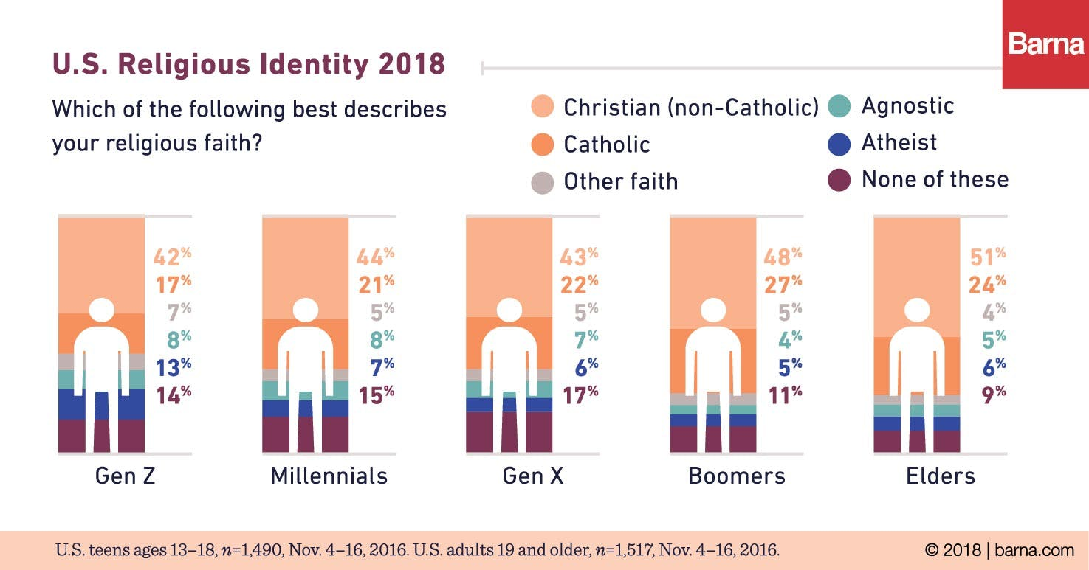
Notes:
This is going to be a long-term trend. Why? Because we see each generation getting more and more unchurched.
This chart provides a great example. Look at the jump in people identifying as atheist in one generation. Among Millennials it is 7%. But 13% of Gen Z identify as atheists.
The youngest generation in America (sometimes called “iGen”), is the first generation where a good majority have almost no church experience. They perhaps have set foot in a church on Christmas Eve with grandma or to attend a funeral. But other than that, they no nothing about religion. For the first time in American history, we have a substantial portion of the younger population that has no contact with church at all. Religion is going to seem odd to them. More on this later.

Slide 19
Notes:
This is significant because many conversions take place as a result of spousal encouragement.
Pastors: How many of your adult confirmands are the result of “marital conversion?”

Slide 20
Notes:
This is significant because if you are raised in religion you are more likely to be interested in and familiar with religion

Slide 21

Notes:
All of this is having a snowball effect. Fewer children being raised religiously leads to fewer unaffiliated marrying religious spouses. Etc.

Slide 22
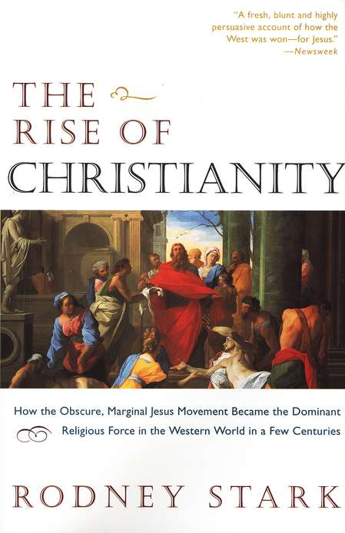
Notes:
(1996) The opposite happened in the early Church. Epidemics in 165 and 251 killed many, but far more pagans than Christians. This meant the pagans who survived had a much higher chance of connecting with Christians which led to conversions as well as marriages which led to conversions which led to Christian children, etc. etc.

Slide 23
Why?
The rise of the Unaffiliateds
Shifts in the Unaffiliateds’ views on religion

Slide 24

SHIFT
Postmodernism
has led to
religious pluralism.
Notes:
So, we have said that American Christianity as a whole is unraveling. Let’s dig into some of the underlying reasons. What follows are some massive religious cultural shifts contributing to this decline.
First, postmodernism has led to religious pluralism. Postmodernism is a philosophy that came to prominence in the last part of the 20th century. It’s central tenet is that there is no such thing as absolute truth. Truth is subjective and personal. What is “truth” for you is not necessarily truth for me. Think of what that does to religion. Christianity ceases to be absolute truth: Jesus is God and man; he died for sins and rose again, seen by more than 500 witnesses; etc. Christianity is one of many possible coping mechanisms. If believing that when you die you go to heaven gives you comfort, that’s your truth. But if your neighbor is comforted by the thought that when his dad died, he became one with nature, that’s his truth. If you believe Jesus is God and that gives you peace and purpose, that’s your truth. But if you believe Allah is God and that gives you peace and purpose, that’s fine too. That’s religious pluralism. All religions are equally valid, because they are all equally true to their followers.

Slide 25
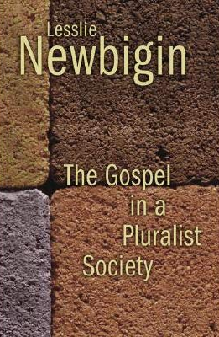
TWO PREDICTIONS
The church would be viewed as irrelevant.
Churches with exclusivity claims would be perceived especially negatively.
2014 SURVEY (BARNA GROUP)
“Is attending church important?” 2 in 10 of those under the age of 30 say “yes.”
“The church does more harm than good.” 1 in 3 of those under the age of 30 say agree.
Notes:
In 1989, a Reformed theologian named Lesslie Newbigin wrote a book about the rise of religious pluralism titled The Gospel in a Pluralist Society. He made two predications. First, Newbigin said that as religious pluralism caught on, churches would be viewed as irrelevant. After all, if churches don’t have the truth but simply offering coping mechanisms, how important can they be. Second, Newbigin said that as religious pluralism spread, churches that had an exclusivity claiming (i.e. a claim that they were the true religion and others were false) would be viewed negatively. That’s us! We don’t say that Jesus is a way… a truth. We say he’s the way… the truth… the life. That is pushing your truth upon others, which is a no-no in a postmodern, pluralistic world.
Newbigin’s predictions were spot on. A 2014 survey conducted by the Barna Group asked people under the age of 30, “Is attending church important?” Only 2 in 10 said yes. The church has become irrelevant in the eyes of that younger generation. The survey asked if they agreed with the statement, “The church does more harm than good.” 1 in 3 said yes.
https://www.barna.com/research/americans-divided-on-the-importance-of-church/

Slide 26
SHIFT
Secular humanism has become
the basis for morality and ethics.
Notes:
Those first two shifts – the rise of secular humanism and religious pluralism – have led to this third shift. There is no longer any guilt in not following Christian norms. Fifty years ago, people typically would not want to admit they didn’t go to church. Today, people don’t care about admitting that.
You really see this in youth sports. When I was a child, there was no soccer or softball on Sundays. But when I served as a parish pastor in Charleston, SC (the very conservative buckle of the Bible belt), even there I had to compete with Sunday youth sports.

Slide 27
sec·u·lar hu·man·ism| ˈsekyələr ˈ(h)yo͞oməˌnizəm | noun
humanism, with regard in particular to the belief that humanity is capable of morality and self-fulfillment without belief in God.
Notes:
Those first two shifts – the rise of secular humanism and religious pluralism – have led to this third shift. There is no longer any guilt in not following Christian norms. Fifty years ago, people typically would not want to admit they didn’t go to church. Today, people don’t care about admitting that.
You really see this in youth sports. When I was a child, there was no soccer or softball on Sundays. But when I served as a parish pastor in Charleston, SC (the very conservative buckle of the Bible belt), even there I had to compete with Sunday youth sports.

Slide 28

Notes:
You can find the video at this link: https://www.youtube.com/watch?v=9tpL1K8ZqrU&t=76s
This video was put together by a group trying to promote secular humanism.

Slide 29
SHIFT
There is no longer any guilt in
not following Christian norms.
Notes:
Share examples.

Slide 30
THE GOOD NEWS
Young people ARE interested in spiritual issues

Slide 31


Slide 32
THE CHALLENGE
Young people do NOT trust institutions

Slide 33
Trust
Confidence in Institutions
Institution 1970s Today
Big Business 26% 23%
The Medical System 80% 36%
The Presidency 52% 38%
Television News 46% 18%
Congress 42% 11%
Newspapers 39% 23%
Public Schools 58% 29%
Banks 60% 30%
Organized Religion 65% 36%
Source: Gallup
Percent Answering Great Deal/Quite a Lot on 5-point scale
Notes:
https://news.gallup.com/poll/1597/confidence-institutions.aspx

Slide 34
Trust
Confidence in Institutions
Institution 1970s Today
Big Business 26% 23%
The Medical System 80% 36%
The Presidency 52% 38%
Television News 46% 18%
Congress 42% 11%
Newspapers 39% 23%
Public Schools 58% 29%
Banks 60% 30%
Organized Religion 65% 36%
Source: Gallup
Percent Answering Great Deal/Quite a Lot on 5-point scale
Notes:
https://news.gallup.com/poll/1597/confidence-institutions.aspx

Slide 35
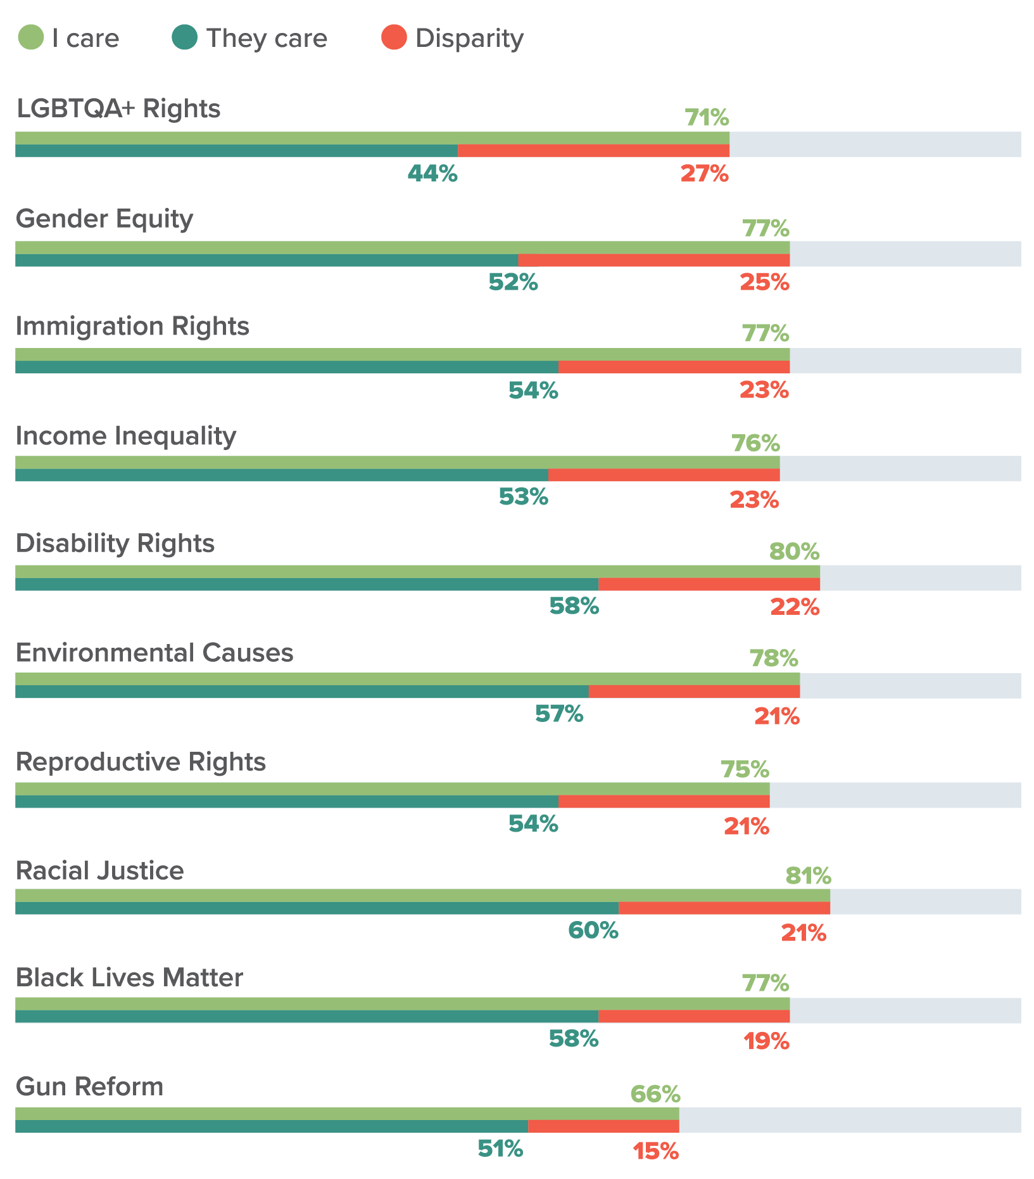
The Disconnect

Slide 36


THE COLLAPSE OF THE “CHURCH SHOPPER”
In 1980, 1 in 3 unchurched Americans were actively looking for a church to join.
Today, that number is 1 in 30.

Slide 37

Look back at the shifts in the Unaffiliateds’ views on religion.
Why do these shifts make personal witnessing all the more important?
Notes:
So…more and more of the Unaffiliated DO NOT WANT WHAT THEY THINK THE CHURCH IS OFFERING

Slide 38

Notes:
If a person does not enjoy golf, it does no good to say:
We have the most challenging course
We have the best rental clubs
We have the nicest greens
Or even:
We drink beer after every round
We have really nice members at our club
They don’t care because they don’t feel they need what you are offering or they can get it elsewhere without having to golf.
BUT…if I have a relationship with that person and invite them, they might just come out of respect for the relationship

Slide 41
Notes:
Dr. Rick Richardson.

Slide 42
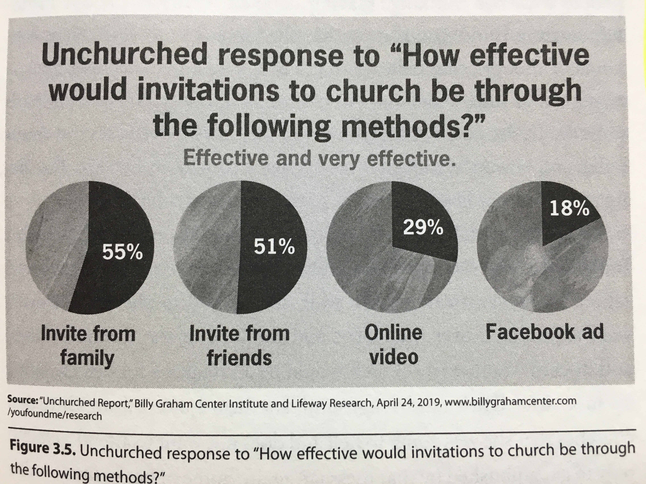

Slide 43

Non-Christians prefer to explore faith with a
______ _______
rather than an
______ _____

Slide 44
Non-Christians prefer to explore faith with a
______person_______
rather than an
_____institution_____

Slide 45
Why?
What?
How?
Personal
Evangelism

Slide 46
Define “evangelism”

Slide 47
Εὐαγγέλιον =
Good News

Slide 48
“ Go into all the world and preach the good news (Εὐαγγέλιον) to all creation.”
- Mark 16:15

Slide 49
What is the good news?

Slide 50
Identify blessings you have as a Christian that a non-Christian does not have.

Slide 51
Christian Blessings
God’s forgiveness
Power to forgive others
Confidence that God is in control and loves us
Purpose in life
Confidence to face death
Prayer
Trustworthy guidance for life
Comfort when a Christian loved one dies
Eternal life

Slide 52
Who is more likely to talk to someone about Jesus – a five-year-old or a nineteen-year-old?
Why do you think this is?
How do you think this
could be changed?
Notes:
Doesn’t care what others think about him
Isn’t afraid he won’t know all the answers
Others?

Slide 53
Why?
What?
How?
Personal
Evangelism

Slide 54


Slide 56
LOVE
“God so loved the world that he gave his one and only Son that whoever believes in him will not perish but have eternal life.”
- John 3:16

Slide 57
LOVE
Identify one type of person you might find it challenging to love.

Slide 58


Slide 59
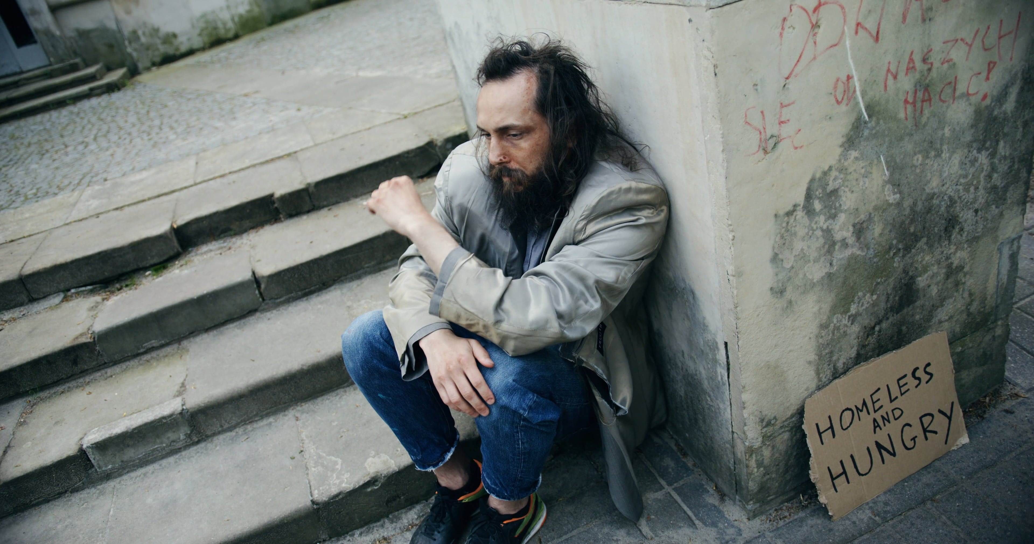

Slide 60


Slide 61
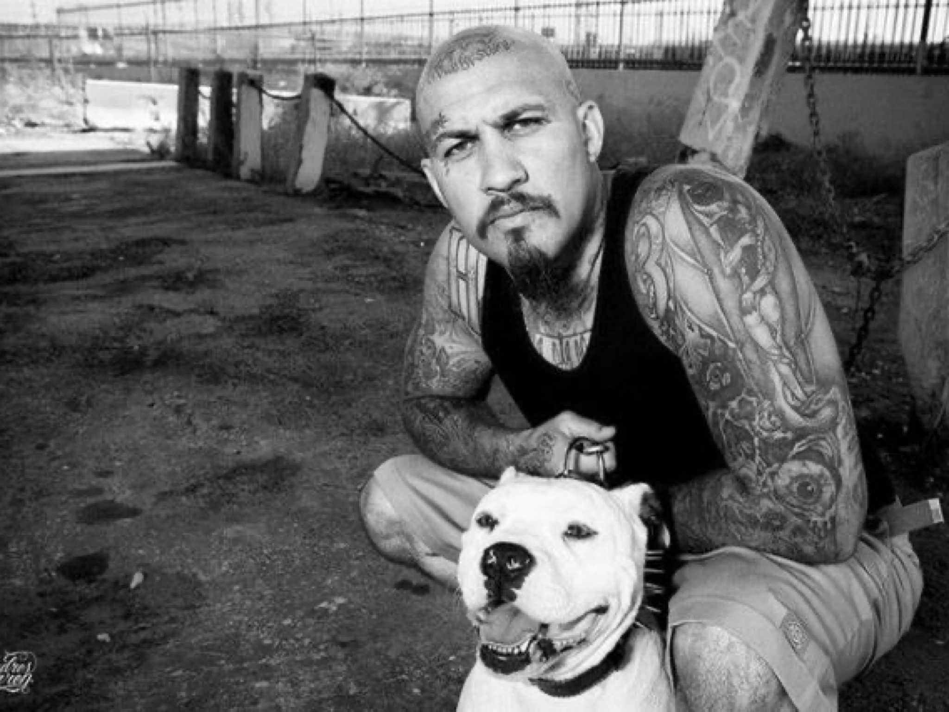

Slide 62
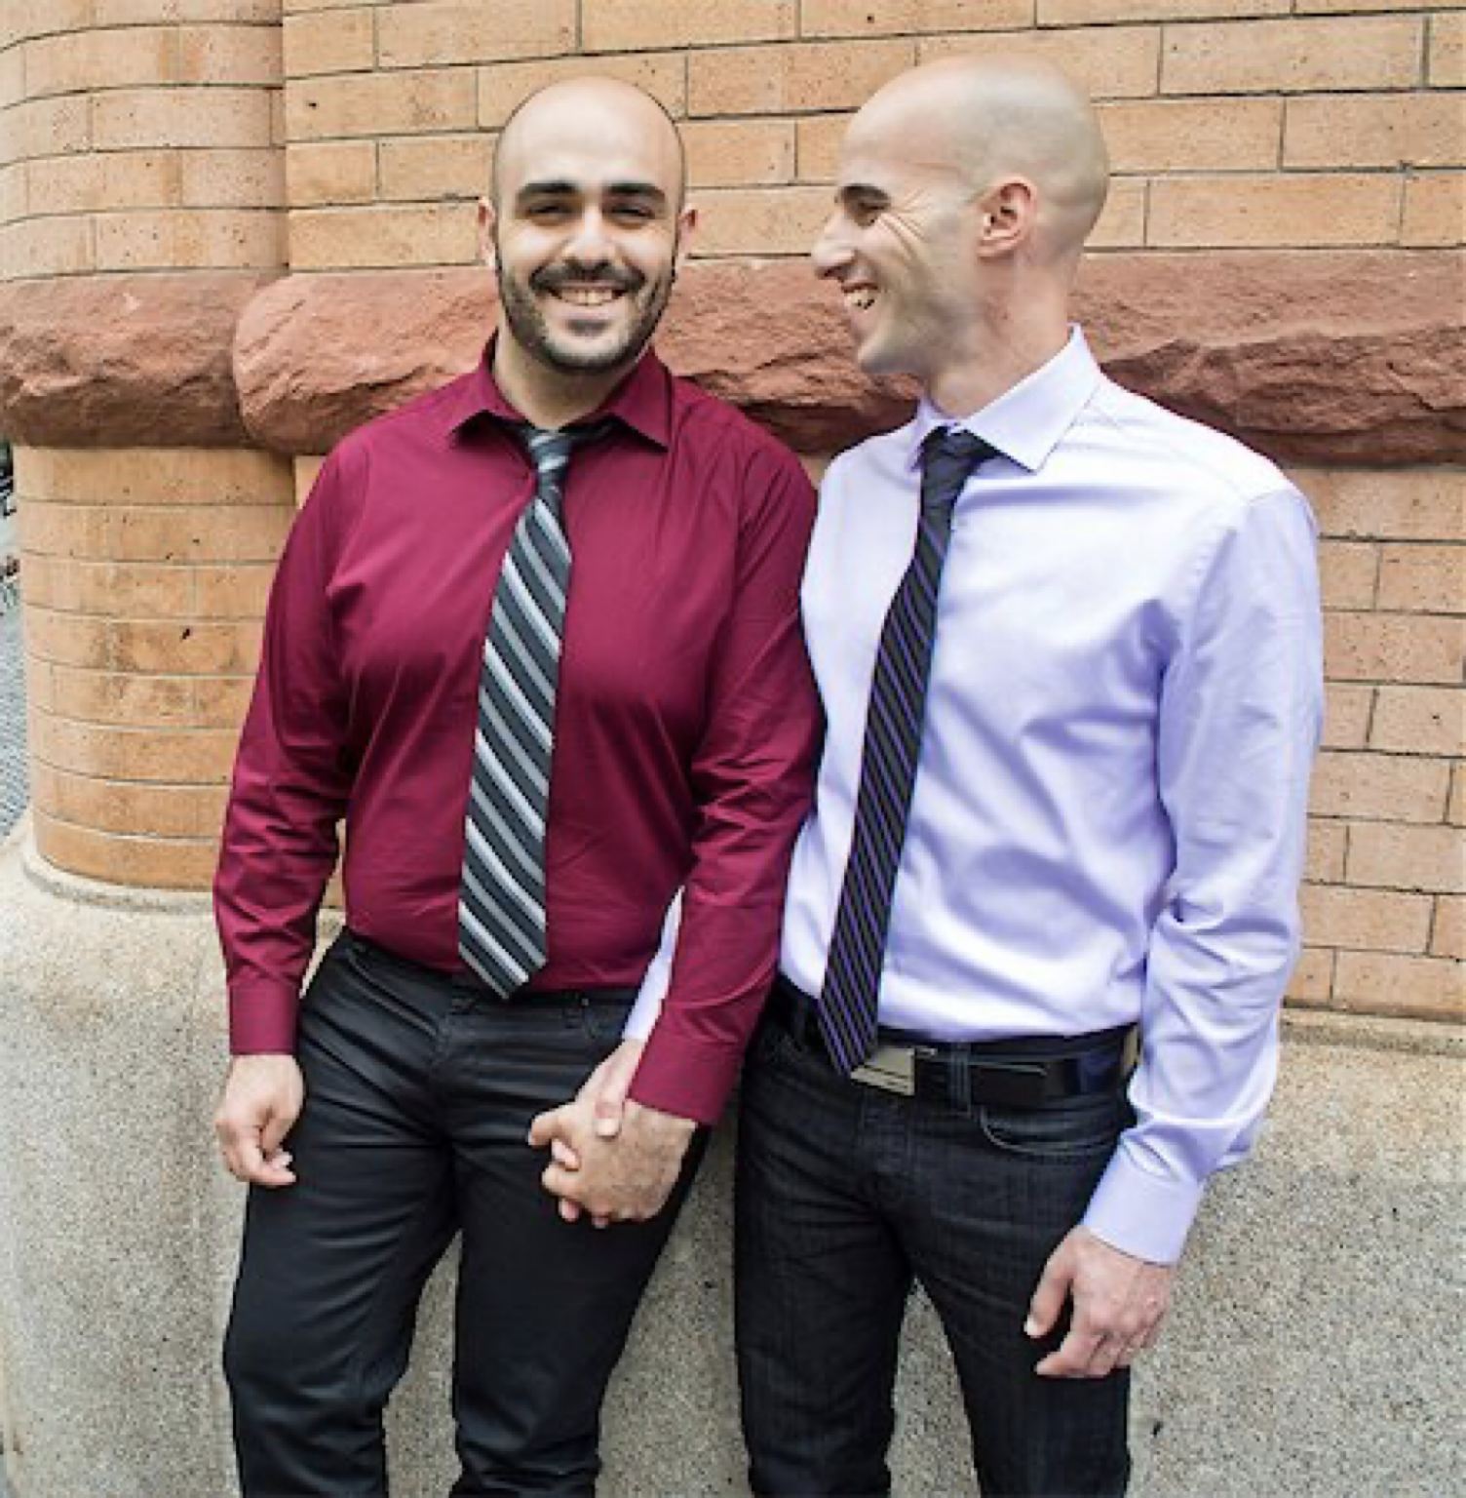

Slide 63
LOVE
Think of an unchurched person the Lord has brought into your life.
What is one way you could demonstrate love toward them in the near future?

Slide 64
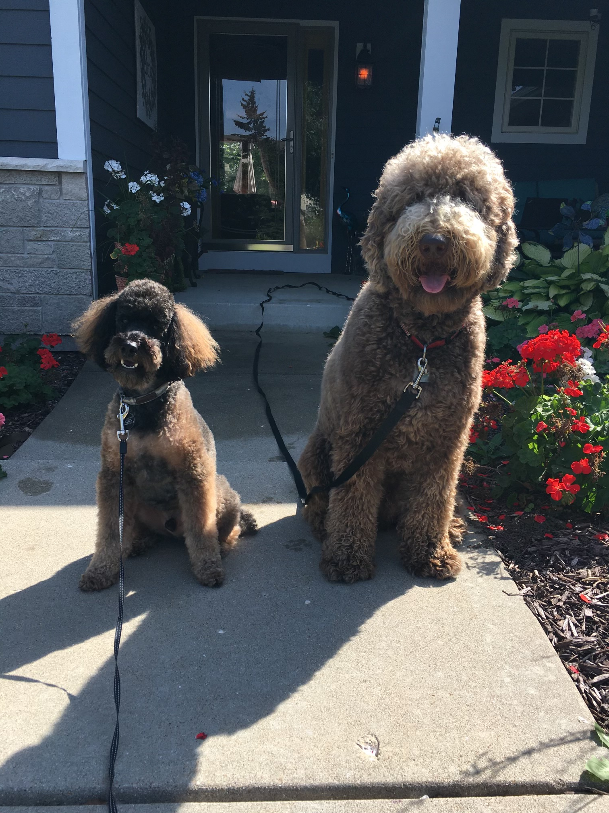

Slide 66
LISTEN
“My dear brothers, take note of this: Everyone should be quick to listen, slow to speak and slow to become angry”
- James 1:19

Slide 67
LISTEN
Identify at least two reasons why listening carefully is so important when personally witnessing.

Slide 68
LISTEN
It shows you care
It shows respect
It builds trust
It informs your witness

Slide 69
LISTEN
“What makes you say that?”
“What has led you to that conclusion?”
“Have you ever considered…”

Slide 70
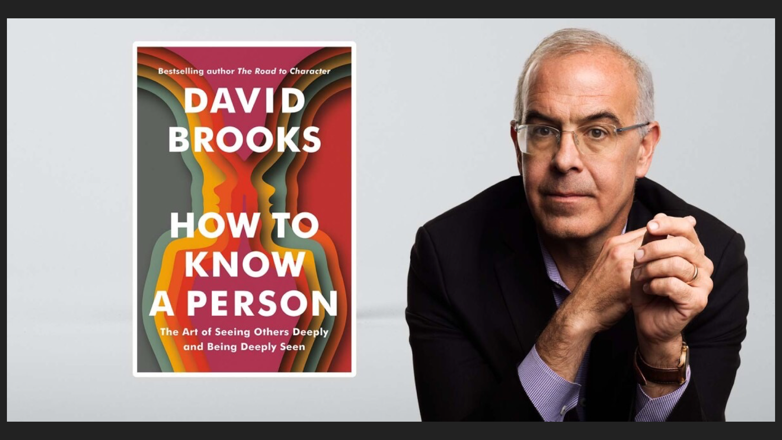
David

Slide 72
LEAD
Invitation
Proclamation

Slide 73
LEAD
Invitation
Identify at least three events/occasions to which you could invite an unchurched person to hear the gospel.

Slide 74
LEAD
Proclamation
Law or Gospel?
Truth
Apostles’ Creed
Major in the majors
Personal Testimony
Apologetics

Slide 75
Love
Listen
Lead

Slide 76
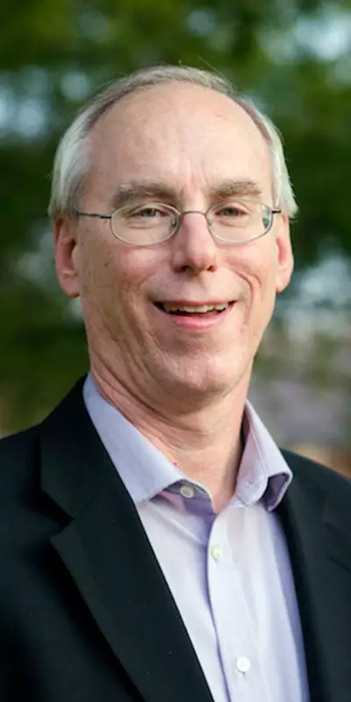

Slide 77
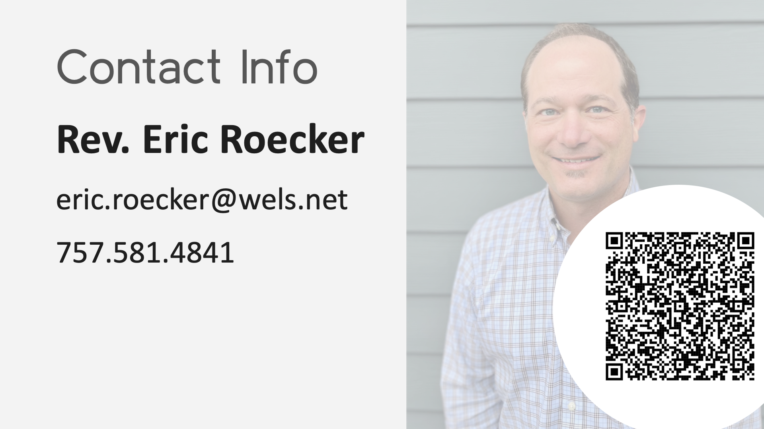
Rev. Eric Roecker
Director – WELS Commission on Evangelism
eric.roecker@wels.net
414-256-3287

